Slide 1
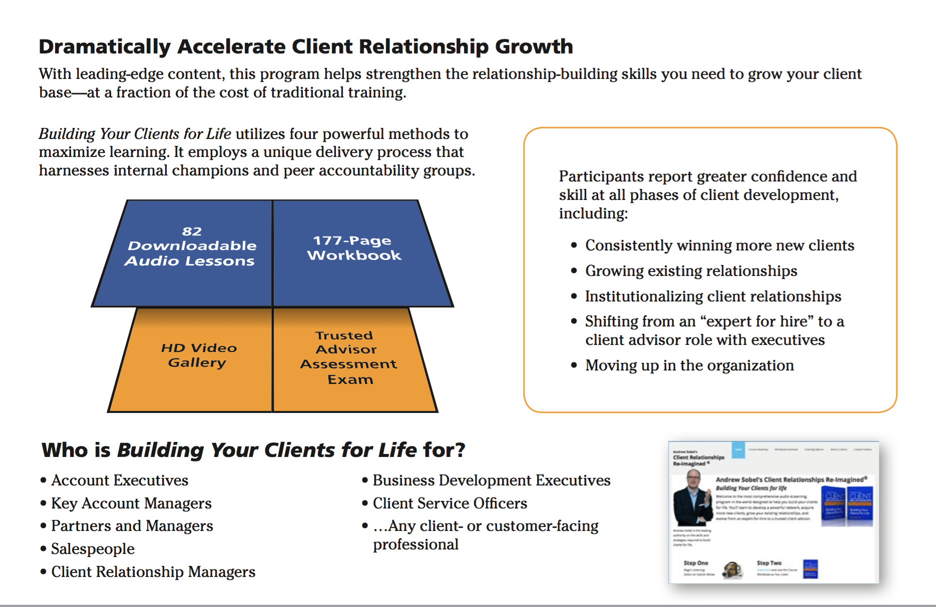
Our mobile learning program, Building Your Clients for Life, is the most comprehensive digital learning resource of its kind.
Based on the most extensive research ever conducted on the ingredients of long-term client relationships
Allows you to scale training and build trusted advisor skills across 100, 500, or even 5000 people, using internal champions to lead small accountability groups.
Serves as a powerful reinforcement to live training and coaching, but can also be used as a stand-alone resource
Provides 16 hours of training (26 hours if small groups are utilized), giving participants hundreds of proven strategies, tools, and techniques for building clients for life.
Contact us to learn more, see a demo, and get pricing information >>
Download a brochure>>
“We highly recommend this program. It chunks the information into small, easily digestible, yet very informative, lessons that our team can carry with them as they travel…”
--Morgan Massie, Human Capital Talent Manager, TriNet

Slide 2
